Slide 1


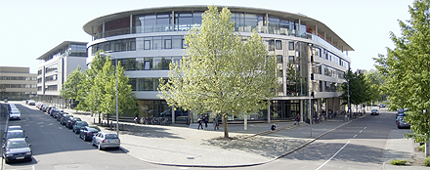
3rd IMPRS NeuroCom Summer School, Leipzig, Germany
10 - 12 July 2013
Free energy and active inference
Karl Friston
Abstract
How much about our interaction with – and experience of – our world can be deduced from basic principles? This talk reviews recent attempts to understand the self-organised behaviour of embodied agents, like ourselves, as satisfying basic imperatives for sustained exchanges with the environment. In brief, one simple driving force appears to explain many aspects of action and perception. This driving force is the minimisation of surprise or prediction error that – in the context of perception – corresponds to Bayes-optimal predictive coding (that suppresses exteroceptive prediction errors) and – in the context of action – reduces to classical motor reflexes (that suppress proprioceptive prediction errors). We will look at some of the phenomena that emerge from this principle; such as hierarchical message passing in the brain and the perceptual inference that ensues. These perceptual abilities rest upon prior beliefs about the world – but where do these beliefs come from? We will consider recent proposals about the nature of prior beliefs and how they underwrite active sampling of the sensorium. Put simply, to minimise surprising states of the world, it is necessary to sample inputs that minimise uncertainty about the causes of sensory input. When this minimisation is implemented via prior beliefs – about how we sample the world – the resulting behaviour is remarkably reminiscent of visual searches and other forms of active inference. In short, if percepts correspond to hypotheses, then action could be construed as sampling data to test perceptual hypotheses – and accrue evidence for our very existence. I hope to illustrate these points using simulations of action observation and saccadic eye movements.

Slide 2

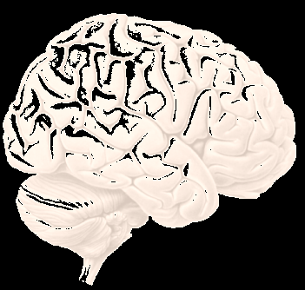
Active inference and predictive coding
Active inference and action observation
Active inference and saccadic searches

Slide 3
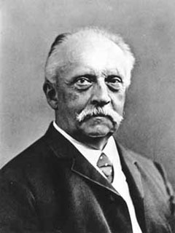
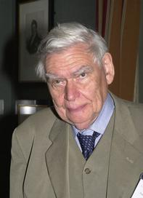
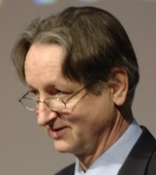
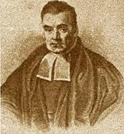

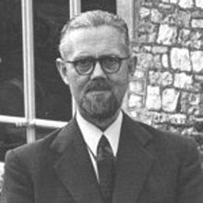
“Objects are always imagined as being present in the field of vision as would have to be there in order to produce the same impression on the nervous mechanism” - von Helmholtz
Hermann von Helmholtz
Richard Gregory
Geoffrey Hinton
From the Helmholtz machine to the Bayesian brain and self-organization
Thomas Bayes
Richard Feynman
Ross Ashby

Slide 4
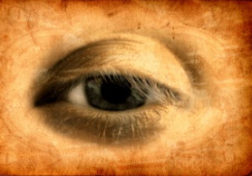
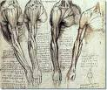
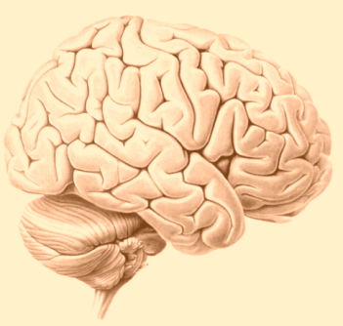
How do we minimize prediction errors (free energy)?
sensations – predictions
Prediction error
Change sensations
Change
predictions
Action
Perception

Slide 5

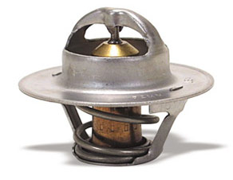
Action as inference – the “Bayesian thermostat”
Posterior distribution
Prior distribution
Likelihood distribution
20
40
60
80
100
120
temperature
Perception
Action

Slide 6
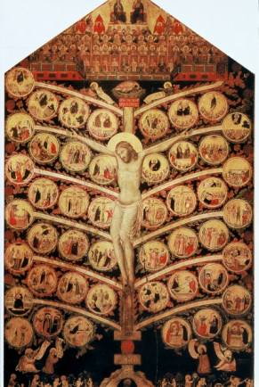
From models to perception
A simple hierarchy
Generative model
Descending
predictions
Model inversion (inference)
Expectations:
Ascending prediction errors
Predictions:
Prediction errors:

Slide 7

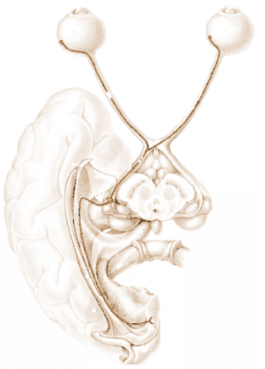
David Mumford
Predictive coding with reflexes
Action
oculomotor signals
reflex arc
proprioceptive input
pons
retinal input
Perception
Prediction error (superficial pyramidal cells)
frontal eye fields
geniculate
Top-down or backward predictions
Conditional predictions (deep pyramidal cells)
Bottom-up or forward prediction error
visual cortex

Slide 8
Prediction error can be reduced by changing predictions (perception)
Prediction error can be reduced by changing sensations (action)
Perception entails recurrent message passing in the brain to optimize predictions
Action fulfils descending predictions

Slide 9
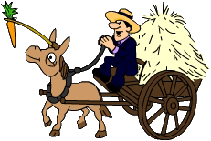
Action as inference – the “Bayesian thermostat”
Prior distribution
20
40
60
80
100
120
temperature
Perception:
Action:

Slide 10
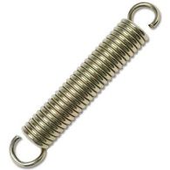
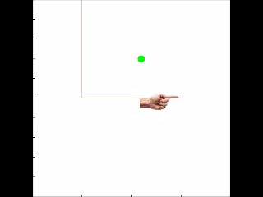
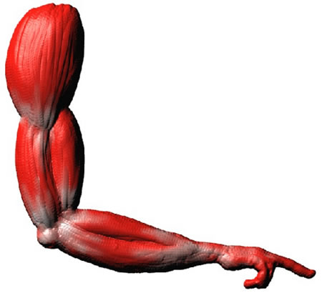
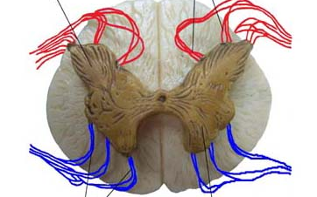
Action with point attractors
visual input
Exteroceptive predictions
Descending
proprioceptive predictions
proprioceptive input

Slide 11

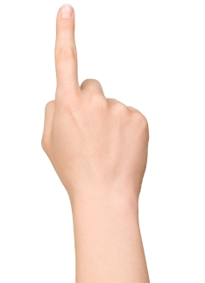
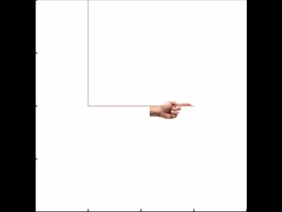
Heteroclinic cycle (central pattern generator)
Descending
proprioceptive predictions
action
observation
0.4
0.6
0.8
position (y)
1
1.2
1.4
0
0.2
0.4
0.6
0.8
1
1.2
1.4
0
0.2
0.4
0.6
0.8
1
1.2
1.4
position (x)
position (x)

Slide 12
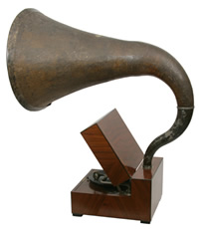
If percepts are hypotheses, where do we look for evidence?
Richard Gregory

Slide 13
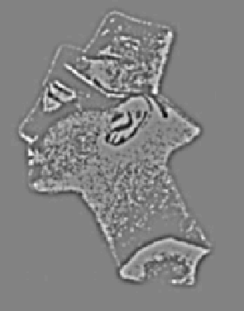
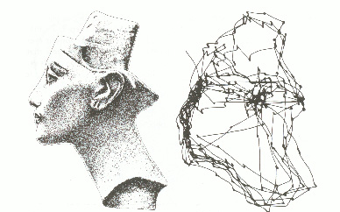
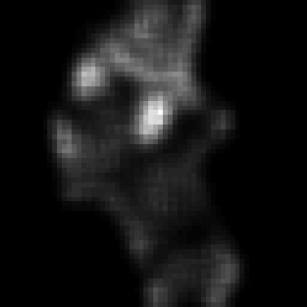
Sampling the world to minimise uncertainty
Free energy minimisation
minimise uncertainty
stimulus
visual input
salience
sampling
Perception as hypothesis testing – saccades as experiments

Slide 14
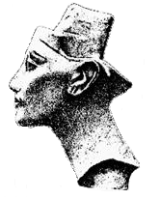
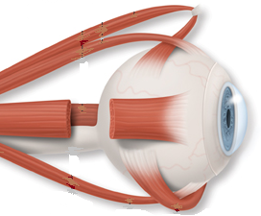
Parietal (where)
Frontal eye fields
Visual cortex
Fusiform (what)
Pulvinar salience map
oculomotor reflex arc
Superior colliculus

Slide 15
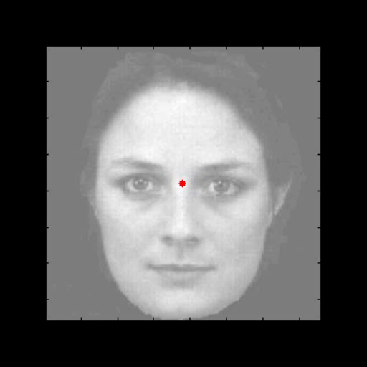
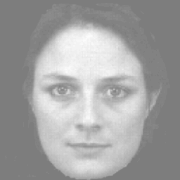
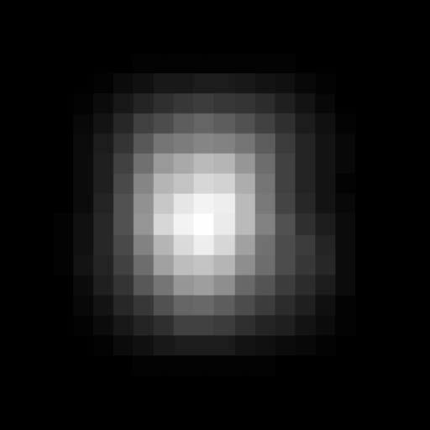
Saccadic eye movements
Saccadic fixation and salience maps
Hidden (oculomotor) states
Visual samples
Conditional expectations about hidden (visual) states
And corresponding percept

Slide 16
Hermann von Helmholtz
“Each movement we make by which we alter the appearance of objects should be thought of as an experiment designed to test whether we have understood correctly the invariant relations of the phenomena before us, that is, their existence in definite spatial relations.”
'The Facts of Perception' (1878) in The Selected Writings of Hermann von Helmholtz, Ed. R. Karl, Middletown: Wesleyan University Press, 1971 p. 384

Slide 17
Thank you
And thanks to collaborators:
Rick Adams
Andre Bastos
Sven Bestmann
Harriet Brown
Jean Daunizeau
Mark Edwards
Xiaosi Gu
Lee Harrison
Stefan Kiebel
James Kilner
Jérémie Mattout
Rosalyn Moran
Will Penny
Lisa Quattrocki Knight
Klaas Stephan
And colleagues:
Andy Clark
Peter Dayan
Jörn Diedrichsen
Paul Fletcher
Pascal Fries
Geoffrey Hinton
James Hopkins
Jakob Hohwy
Henry Kennedy
Paul Verschure
Florentin Wörgötter
And many others

Slide 18
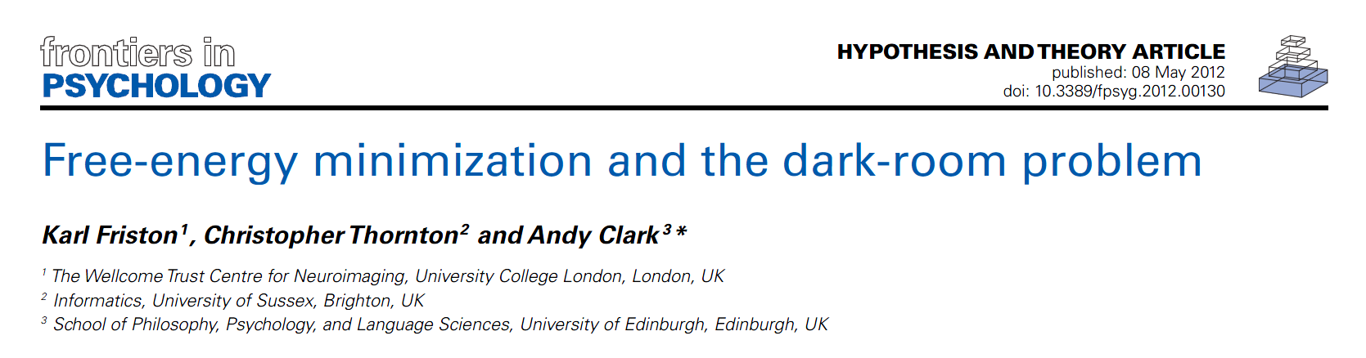

Searching to test hypotheses – life as an efficient experiment
Free energy principle
minimise uncertainty

Slide 19
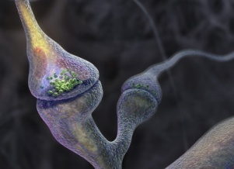
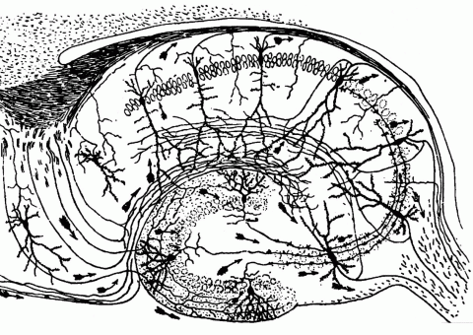
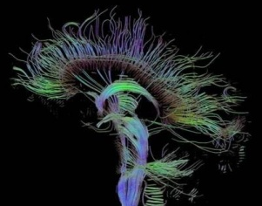
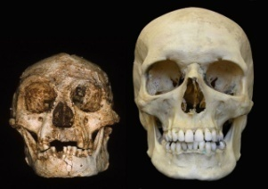
Time-scale
Free-energy minimisation leading to…
Perception and Action: The optimisation of neuronal and neuromuscular activity to suppress prediction errors (or free-energy) based on generative models of sensory data.
Learning and attention: The optimisation of synaptic gain and efficacy over seconds to hours, to encode the precisions of prediction errors and causal structure in the sensorium. This entails suppression of free-energy over time.
Neurodevelopment: Model optimisation through activity-dependent pruning and maintenance of neuronal connections that are specified epigenetically
Evolution: Optimisation of the average free-energy (free-fitness) over time and individuals of a given class (e.g., conspecifics) by selective pressure on the epigenetic specification of their generative models.

